Slide 1

Getting Started with Mini Projects: Ideas, Methodologies and Best Practices
Topics:
SDLC.
3 Tier Architecture.
Types of Applications.
Getting started with new Idea.
Examples.
Presented By:
J Naresh Kumar, Asst. Professor, Dept of Cyber Security, Sphoorthy Engg College.

Slide 2
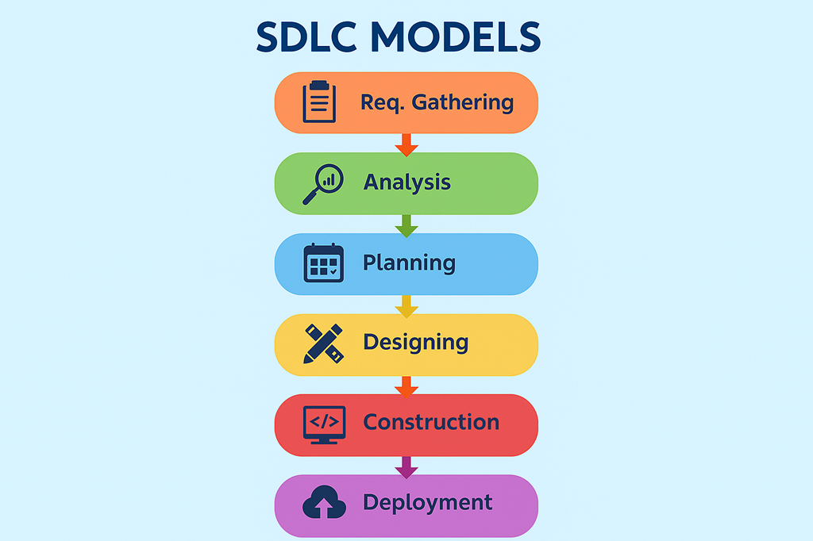

Slide 3
Software Engineering
Web Development: Building websites and web applications
App Development: Building applications for mobile devices
Android Development: Creating applications for the Android platform
AI/ML Engineering: Developing artificial intelligence and machine learning solutions
Data Analysis & Data Science: Extracting insights from data
Cloud & DevOps: Managing cloud infrastructure and continuous deployment
Cyber Security: Protecting systems and data from threats

Slide 4
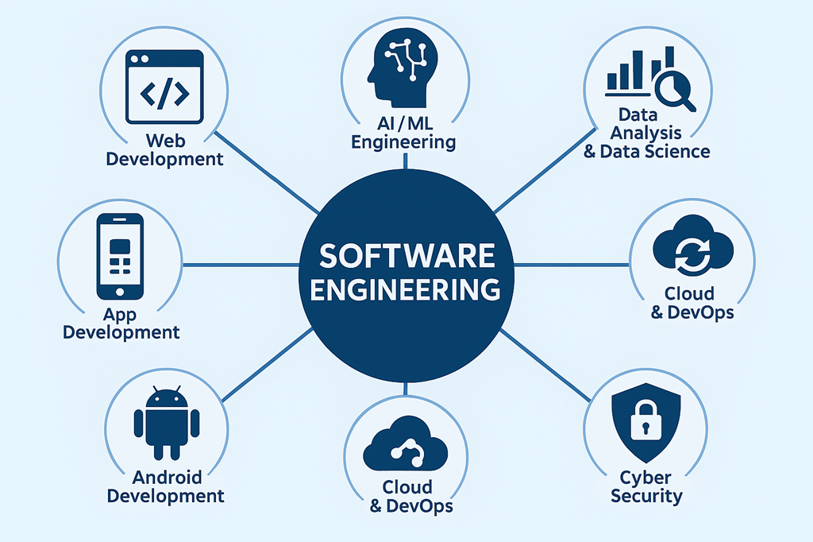

Slide 5
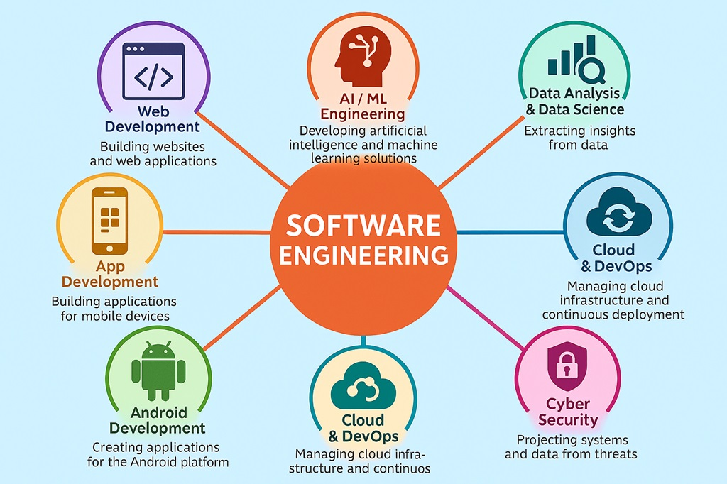

Slide 6

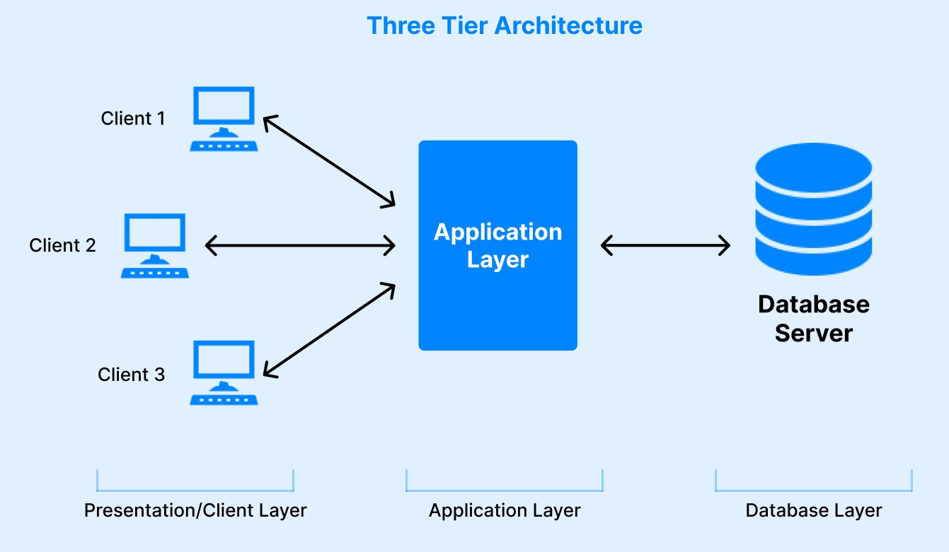
Html, css, js, Frameworks: Angular, React
MySql, Oracle, Sql Server, Mongo DB
Java, PHP, .Net, Python

Slide 7
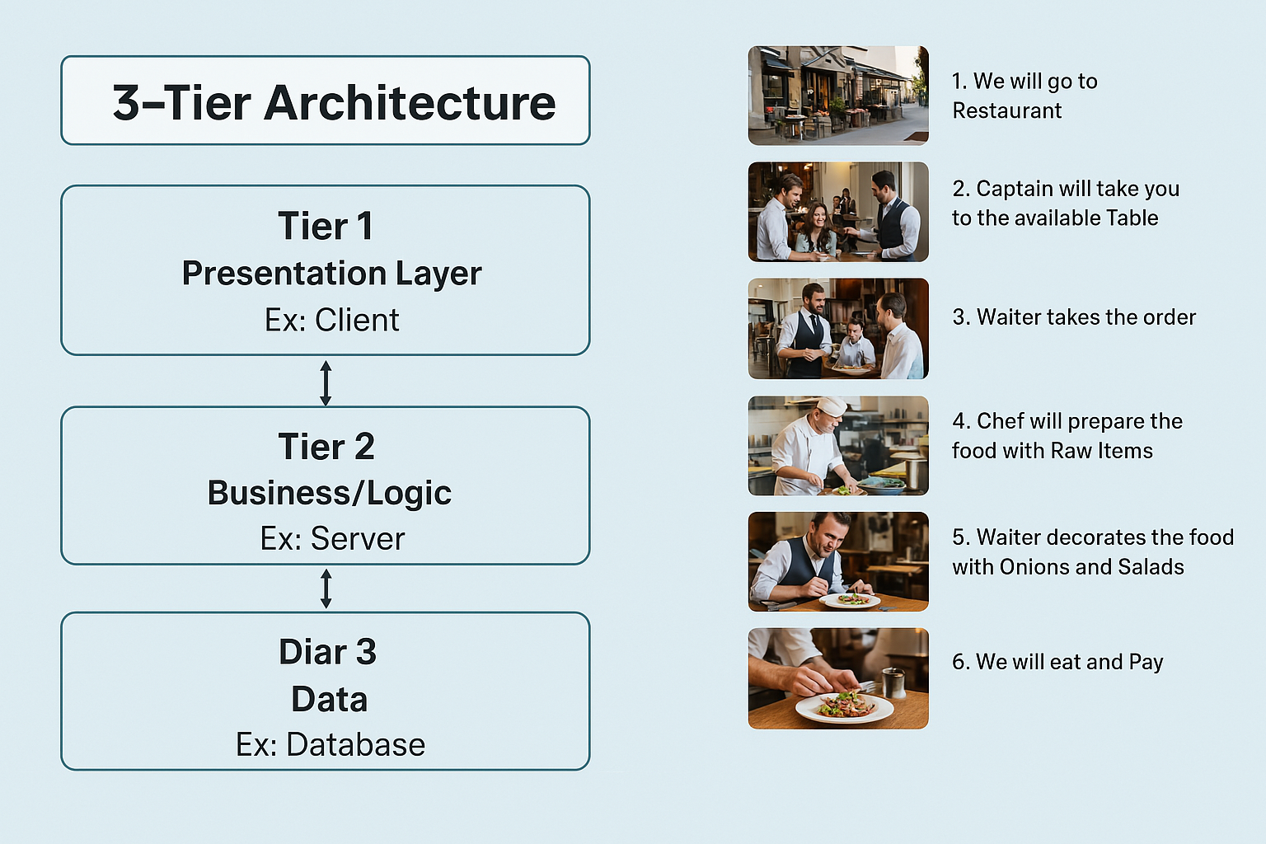

Slide 8
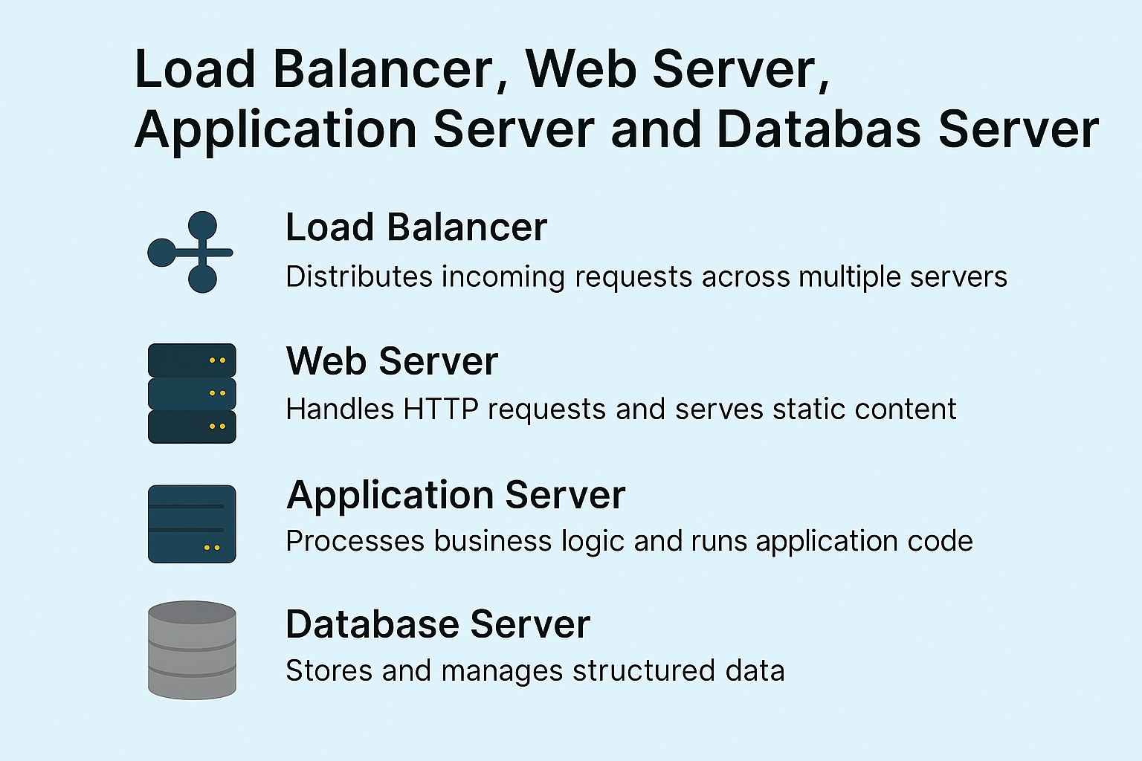

Slide 9
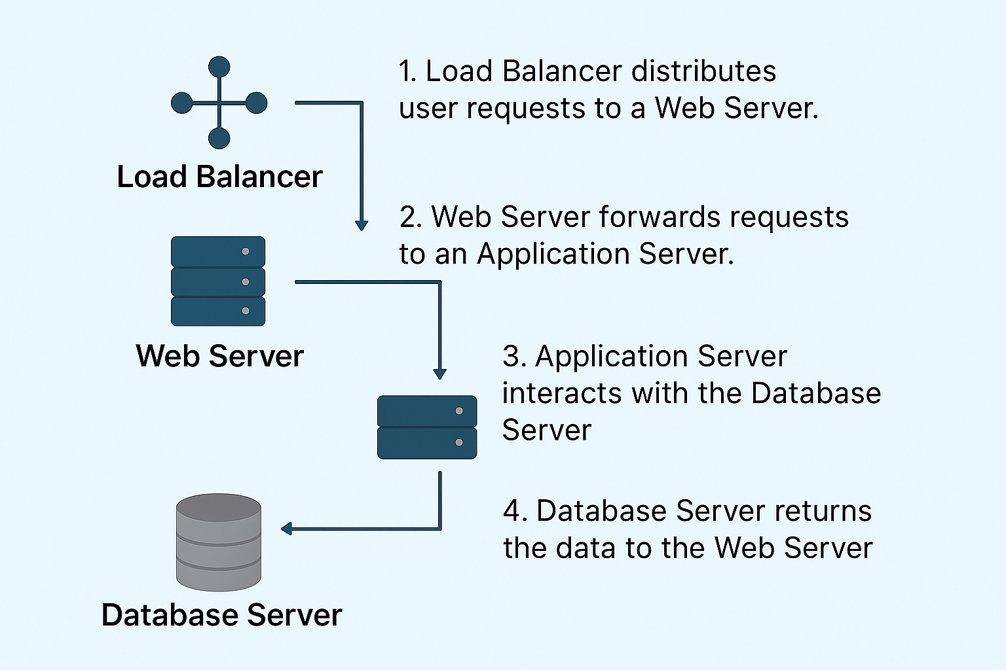

Slide 10
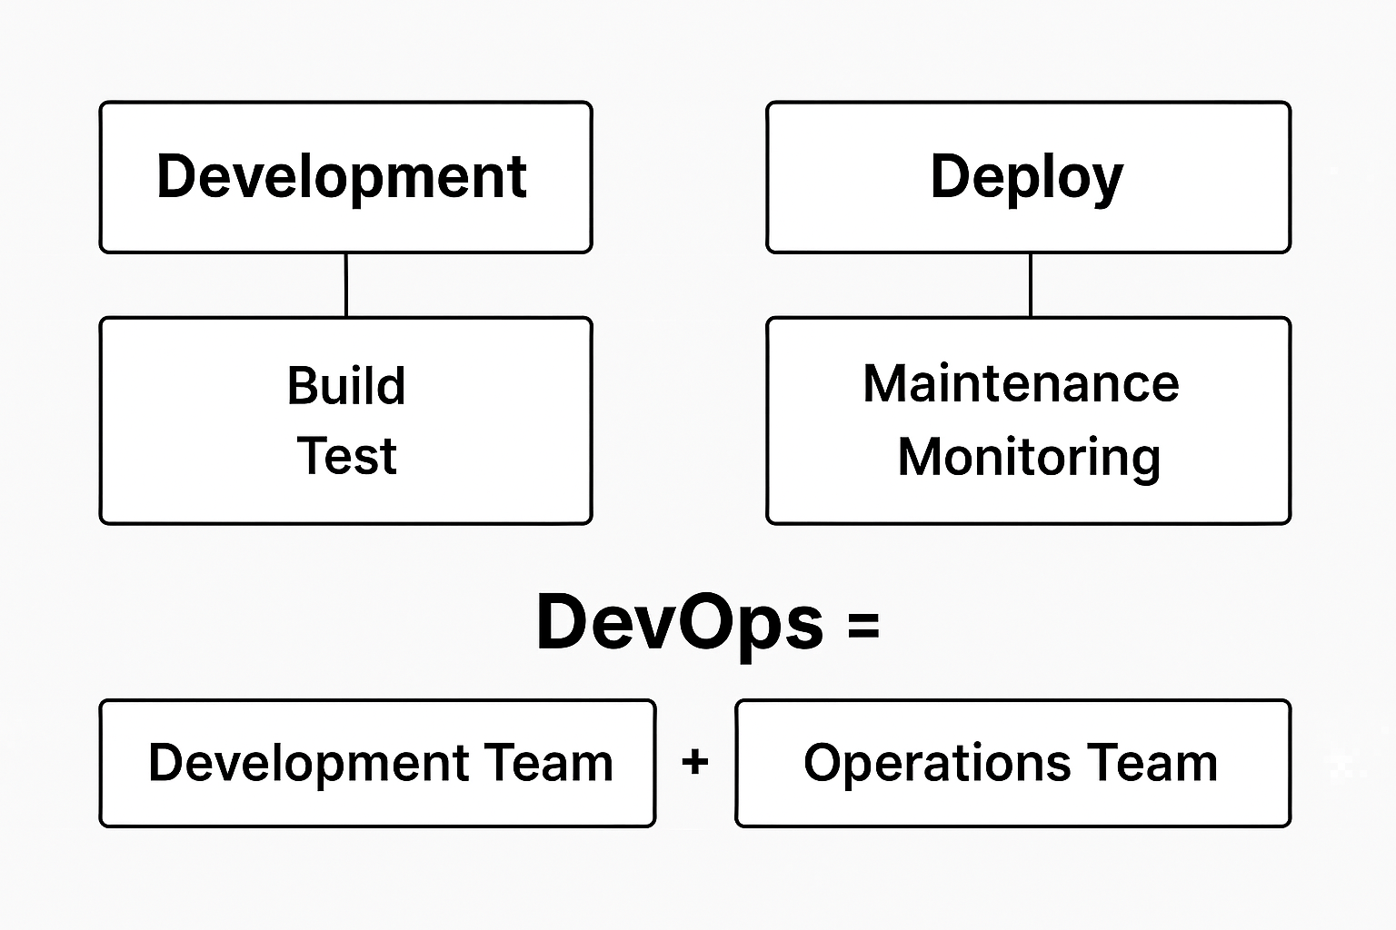
Load Balancer / Web Server - Web Tier
Application Server - Application Tier
Database Server - DB Tier
In between all the 3 tiers we have Network connections, routers and sub networks.
Who is Handling all these tiers ??

Slide 11
Here’s a detailed step-by-step guide for students to proceed with a mini project that showcases technical skills and adds credibility:
1. Identify a Domain & Topic
Choose a domain you are interested in (e.g., Web Development, AI/ML, Data Science, Cybersecurity, Cloud, etc.).
Search for base papers or existing projects on Google Scholar, IEEE, or GitHub for inspiration.
Pick a topic that is feasible within your timeline and aligned with your skills.
2. Analyze Existing Solutions
Understand the problem statement and how existing projects solve it.
Identify limitations or gaps in the current solutions (e.g., performance issues, missing features, cost inefficiency).

Slide 12
3. Add a New Feature or Improvement
Brainstorm innovative features or enhancements:
Improve UI/UX.
Add automation or AI-based predictions.
Make it cost-effective (e.g., use open-source tools instead of paid services).
Ensure the feature is practical and implementable.
4. Plan & Design
Create a project plan:
Define modules and timeline.
Choose tech stack (languages, frameworks, tools).
Design architecture diagrams and UI mockups.

Slide 13
5. Development & Testing
Start coding the base functionality first.
Integrate your new feature.
Perform unit testing and integration testing.
Use version control (GitHub/GitLab) for credibility.
6. Documentation
Prepare clear documentation:
Abstract (summary of your project).
Problem Statement.
Proposed Solution.
Architecture & Design.
Implementation Details.
Screenshots & Results.
Tools: MS Word, LaTeX, or Google Docs.

Slide 14
7. Optional: Publication
If you want extra credibility for higher studies or placements, publish your work:
Platforms: IEEE, Springer, ResearchGate, or College Journal.
Write a research paper based on your documentation.
8. Showcase Your Work
Upload your project on GitHub or Portfolio Website.
Create a demo video and share on LinkedIn.
Add it to your resume under “Projects”.

Slide 15
